Slide 1
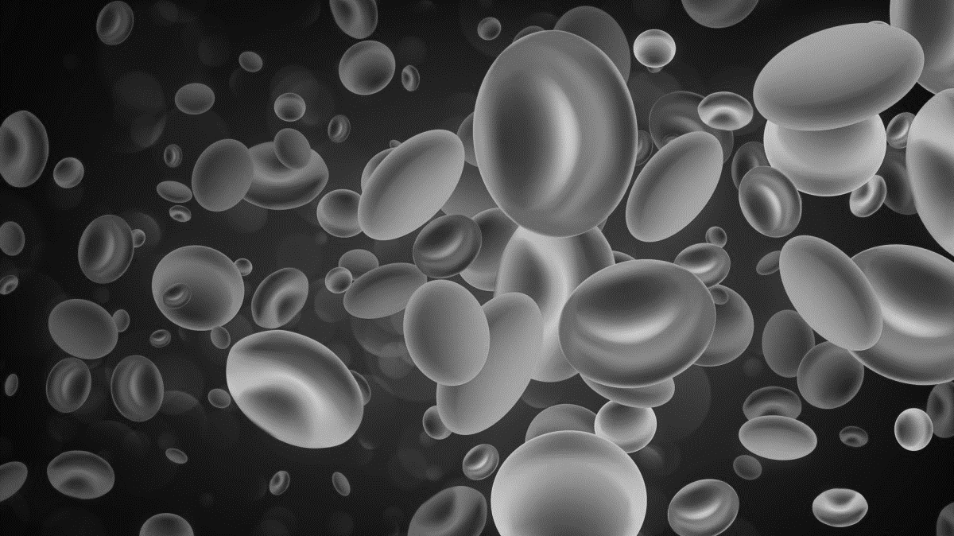

Classification of Cognitive Frailty (CF) in Elderly People using Features Extracted from Blood Samples
Shahidan bin Idris (25204)
Electrical & Electronics Engineering
Supervisor : Associate Professor Dr Nasreen binti Badruddin
Internal Examiner : Dr Mohamad Radzi bin Ahmad

Slide 2
BACKGROUND STUDY
What is Cognitive Frailty (CF)?
“A syndrome in older adults with evidence of both physical frailty and cognitive impairment without a clinical diagnosis of Alzheimer’s Disease (AD) or another dementia.” [1]
Impacts of Cognitive Frailty
Older adults with Cognitive Frailty (CF) group have significant instrumental activities of daily living (IADL) limitations, such as [2]:
Using a bus or a train
Grocery shopping
Management of finances
Housekeeping
For older adults with cognitive impairment, absolute mortality rate is 70% for frail, 45% for pre-frail and 34% for not frail individuals [3]
Source: Department of Statistics – Population by age group, sex and ethnic group, 2010 - 2019e, Malaysia [4]
Prevalence of Cognitive Frailty
37.4%
2.2%
Cognitive Pre-Frail
Cognitive Frail
among older adults in Malaysia, based on a study in 2019 [5]

Slide 3
BACKGROUND STUDY
Identification of Cognitive Frailty
Frailty Measurements
1. Cognitive assessment
Montreal Cognitive assessment test (MoCa) [6]
Mini Mental state Examination (MMsE)
Alzheimer’s disease assessment scale-cognitive subscale (ADAS-Cog).
2. Physical assessment
Gait speed, hand grip strength and weight loss [7]
3. Nutritional assessment to identify dietary deficits
4. Brief psychological assessment
Geriatric depression scale (GDS)
FP Criteria | Measurement
Weakness | Grip Strength: lowest 20% (by sex, body mass index)
Slowness | Walking time/15 ft: slowest 20% (by sex, height)
Low Level of Physical Activity | Kcal/week: lowest 20% Male: 383 Kcal/week Female: 270 Kcal/week
Exhaustion, poor endurance | Self-reported exhaustion
Weight loss | >10 lb lost unintentionally in prior year
Normal: 0 criteria fulfilled
Pre-frail: 1-2 criteria
Frail: 3 and above
Mild Cognitive Impairment (MCI)
Measurements
MoCA Score (Full Score: 30)
Normal: 23 – 30
MCI: 0 – 22

Slide 4
BACKGROUND STUDY
Blood Parameters as Potential Biomarkers to Predict Cognitive Frailty
1. Cognitive Frailty among Malaysian Older Adults: Baseline Findings from the LRGS TUA Cohort Study [5]
Superoxide dismutase - SOD (u.e/min/mg protein)
Malondialdehyde - MDA (nmol/L)
DNA in tail (%)
Tail Moment (%)
Vitamin D (nmol/L)
Brain-derived neurotrophic factor - BDNF (nmol/L)
Telomerase (nmol/L)
2. Cognitive Frailty: Rational and Definition from an (I.A.N.A./I.A.G.G.) International Consensus Group [8]
Inflammatory markers (e.g. CRP, IL-6)
Beta-amyloid protein (aβ)
apoE4 genotype
Anemia
Serum Albumin
Cholesterol
Vitamin D status

Slide 5
PROBLEM STATEMENT
There is no existing classification model to predict Cognitive Frailty in elderly people using blood samples
Existing models classify Cognitive Frailty based on questionnaire responses and physical/cognitive assessment results, rather than biological parameters (e.g. blood parameters)
Models predicting the condition using biological parameters have been focused on physical frailty and mild cognitive impairment (MCI) separately
Attempts made have mostly conducted clustering (instead of classification) or used statistical analysis techniques rather than modern classification algorithms
PROJECT OBJECTIVES
To develop a model to classify different levels of Cognitive Frailty in elderly people using blood sample parameters
To identify the top features/parameters from blood samples that indicate Cognitive Frailty in elderly people
To evaluate the effectiveness of the model in terms of accuracy, precision, and F1 score

Slide 6
LITERATURE REVIEW
BIOMARKERS (FEATURES) IDENTIFICATION
Article | Dataset | Description | Methodology | Performance | Conclusion
Machine Learning for Family Doctors: A Case of Cluster Analysis for Studying Aging Associated Comorbidities and Frailty [9] | General Practice (GP) electronic health records (eHRs) and patient self-reports 261 records 10 numerical variables | To cluster prefrail and frail older people into the respective groups using parameters which indicate significant pathophysiology disorders associated with frailty | Cluster Identification (for K-Means Algorithm) Elbow Method Clustering K-Means Algorithm | Number of Clusters 3 Results: Cluster 2: Highest non-frail Cluster 3: Highest pre-frail | From analysis of cluster centres for blood parameters, the trends of non-frail vs pre-frail vs frail values can be identified Fasting glucose, Cholesterol, Low-density lipoprotein, glomerular filtration rate, haemoglobin and Haematocrit are identified as potential frailty indicators
Classification and prediction of clinical Alzheimer’s diagnosis based on plasma signaling proteins [10] | Self-collected data 259 plasma samples 120 signaling proteins (features) | To identify signaling proteins in blood plasma that can be used to identify Mild Cognitive Impairment (MCI) and Alzheimer’s disease | Cluster Analysis Significance Analysis of Microarrays (SAM) Classification Algorithm Predictive Analysis of Microarrays (PAM) Validation 50/50 Train-Test split 10-fold Cross Validation | Feature Selection SAM: 19 features PAM: 18 Features Accuracy PAM: 90% positive agreement, 88% negative agreement | 18 types proteins in the blood are found to be capable of predicting MCI

Slide 7
LITERATURE REVIEW
Article | Dataset | Description | Methodology | Performance | Conclusion
Blood-Based Protein Biomarkers for Diagnosis of Alzheimer Disease [11] | Train: Australian Imaging, Biomarkers and Lifestyle (AIBL) study 754 healthy, 207 AD 174 biomarkers Test: ADNI cohort 58 healthy, 112 AD | To identify plasma biomarkers for the diagnosis of Alzheimer disease (AD) and predict AD in individuals | Feature Selection: Random Forest, Generalized boost models, Classification trees, LIMMA, Best First, Greedy stepwise, Forward selection regression, SAM Prediction/Classification Algorithm SVM Validation: Cross-Validation | Biomarkers: 18 biomarkers identified to be significant Accuracy: AIBL: 85% ADNI: 80% | 18 blood-related biomarkers identified that are useful for predicting AD

Slide 8
LITERATURE REVIEW
CLASSIFICATION
Article | Dataset | Description | Methodology | Performance | Conclusion
Importance of medical data preprocessing in predictive modeling and risk factor discovery for the frailty syndrome [12] | Toledo Study for Healthy Aging (TSHA) 474 participants 284 health related parameters Questionnaire answers Blood parameters Vital parameters | To find new potential predictors and to build predictive models for frailty syndrome | Data preparation Missing Value Ratio: threshold 33.33% Imputation: MICE Imputation (minimum correlation threshold 7%) Feature Selection Boruta algorithm Input Optimisation Min-Max Normalisation Classification Models Naïve Bayes, Classification And Regression Trees (CART), bagging CART, C5.0, Random Forest, SVM, and LDA Validation 10-Fold Cross Validation | Accuracy SVM (RBF): 78.31 ± 0.70% Random Forest: 77.46 ± 0.45% | When dealing with medical data, data cleaning, preprocessing and preparation is important before classification. Feature selection is important to find most useful features for classification Using the feature selection technique chosen, the top features were variables from questionnaires about health-related issues, rather than blood or vital parameters

Slide 9
LITERATURE REVIEW
Article | Dataset | Description | Methodology | Performance | Conclusion
Detection of Cognitive Impairment using a Machine-Learning Algorithm [13] | Clinical Research Center for Dementia of South Korea (CREDOS) Training Set: 9885 patients Test Set: 300 patients 24 variables | To develop a machine-learning algorithm for the detection of cognitive impairment (CI) based on the Korean Dementia Screening Questionnaire (KDSQ) and MMSE | Data Preprocessing Cardinality Variable Standardisation Classification Tensorflow Evaluation Holdout Method Accuracy, Sensitivity, & Specificity ROC curve | Accuracy KDSQ: 84.3% MMSE: 88.3% KDSQ + MMSE: 86.3% Sensitivity for detecting CI KDSQ: 91.50% MMSE: 94.35% KDSQ + MMSE: 91.5% Specificity for detecting normal cognition KDSQ: 59.60% MMSE: 59.62% KDSQ + MMSE: 61.5% | MMSE is a more superior screening tool for cognitive impairment, compared to KDSQ Detection of CI in this paper deals with classification using existing medical screening tools, rather than biomarkers
Efficient machine learning based detection of heart disease [14] | UCI Machine Learning Repository - Heart Disease Data Set – 4 (Publicly Accessible Repository) Training Set: Test Set: 303 patients 14 variables | To develop a method of detecting possible heart disease using the Random Forest algorithm | Pre-processing Tuple grouping Classification Random Forest Validation 10-fold Cross validation Holdout Method (75/25 train-test split) | Accuracy (Holdout) RFC: 82.895% Accuracy (Cross Validation) RFC: 84.448% | Random Forest Classification is a powerful classification algorithm when handling blood-based medical features Cross Validation produces better accuracy compared to holdout method

Slide 10
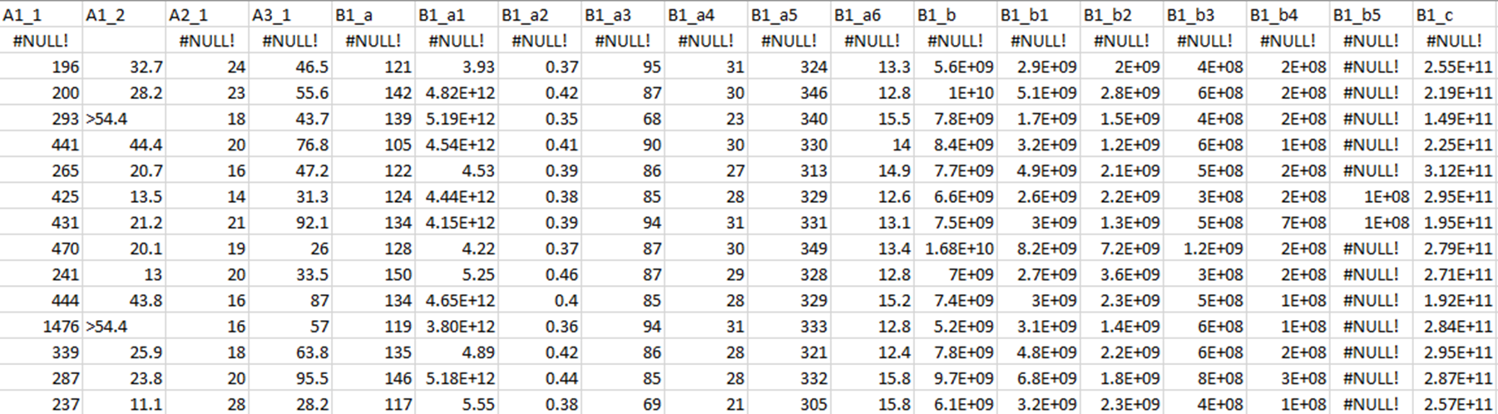
METHODOLOGY
Name | Malaysian Elders Longitudinal Research (MELoR) dataset – Blood Samples Only
Data Format | String and Numerical
Data Shape | 1123 rows, 59 columns Rows: 1123 patients with complete data (Cognitive Frailty + MCI assessments + Blood Sample collected) Columns: Patient ID – 1 column Condition label (Robust, Pre-Frail, Frail, MCI, Pre-frail + MCI, Frail + MCI) – 1 column Blood parameters (e.g. RBC, PCV, Hb1AC) denoted by column codenames which can be referred to a data dictionary – 57 column
Dataset
Data Pre-processing
Feature Selection
Classification
Data Sample
Validation

Slide 11

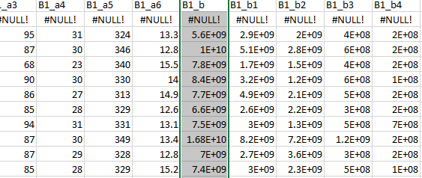
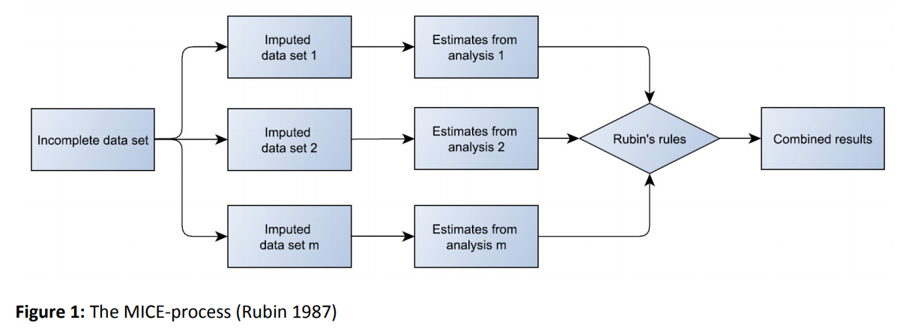
METHODOLOGY
Data Dictionary
1) DATA CLEANING
Handle errors in data entry
Approach: Manual correction by referring to Data Dictionary
Dataset (feature values are scaled)
Dataset
Data Pre-processing
Feature Selection
Classification
2) IMPUTATION
Handle missing values
Techniques:
Missing Value Ratio (Case Deletion)
Threshold 20%
MICE (Multiple Imputation by Chained Equations)
Missing at Random (MAR) data
Validation

Slide 12
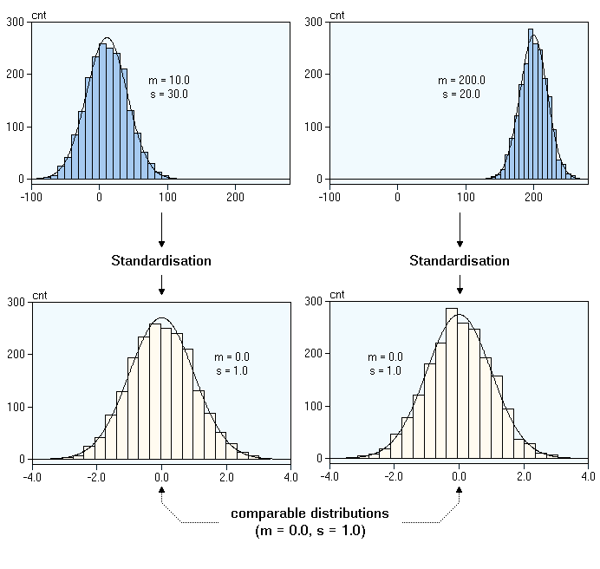
METHODOLOGY
Dataset
3) INPUT OPTIMISATION
Data Standardisation & Normalisation
Standard/Min-Max Scaling (particularly useful for k-Nearest Neighbour & SVM)
Encode Categorical Data (e.g. Labels)
Label-mapping technique
Data Pre-processing
Feature Selection
Classification
Validation

Slide 13
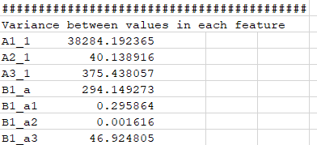
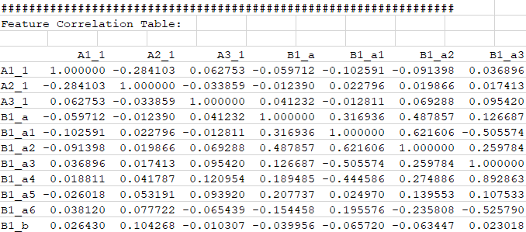
METHODOLOGY
1) LOW VARIANCE FILTER
Checks for variance between each value in a single feature/column
Threshold: 10% (Keep features with more than 10% variance)
Dataset
Data Pre-processing
Feature Selection
Classification
2) HIGH CORRELATION FILTER
Checks for correlation values between features/columns
Threshold: 50% (Remove one of feature-pairs with correlation exceeding 50%)
Validation

Slide 14
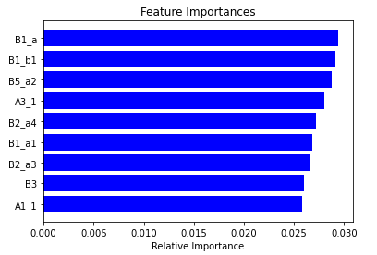
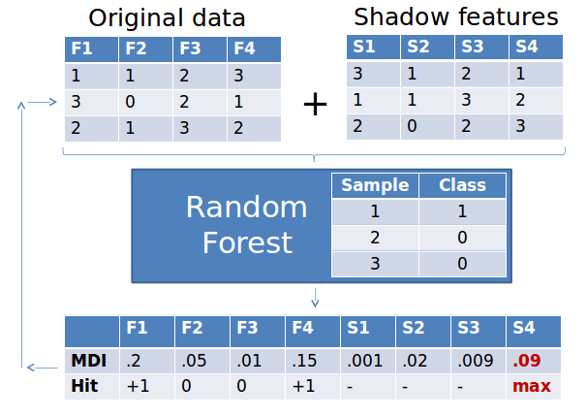
METHODOLOGY
3) RECURSIVE FEATURE ELIMINATION
Greedy optimization algorithm
Repeatedly creates models and keeps aside the best or worst performing feature for each iteration
Constructs the next model with the left features until all features are exhausted
Ranks the features based on order of elimination
Dataset
Data Pre-processing
Feature Selection
4) BORUTA ALGORITHM
Wrapper algorithm around Random Forest
First adds randomness to dataset by creating shuffled copies of features
Trains RFC on extended dataset, applies feature importance measure
At each iteration, checks whether a feature has higher importance than the best of its shadow features
Find all features which are either strongly or weakly relevant to the decision variable
Other algorithms recursively get rid of features, which makes Boruto very suitable for biomedical applications
Classification
Validation

Slide 15
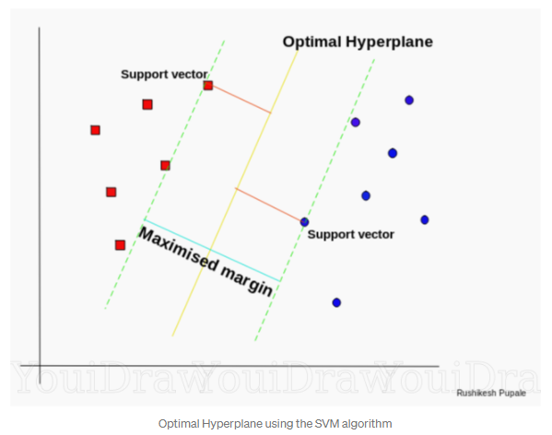
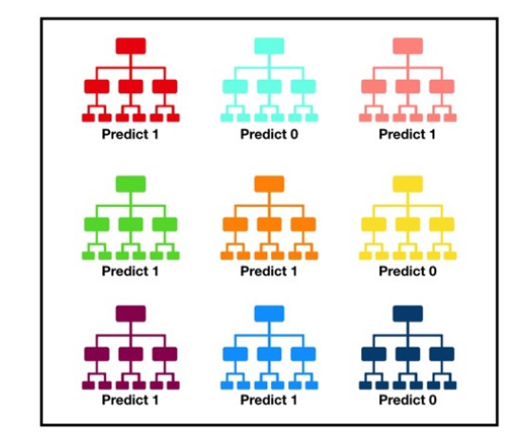
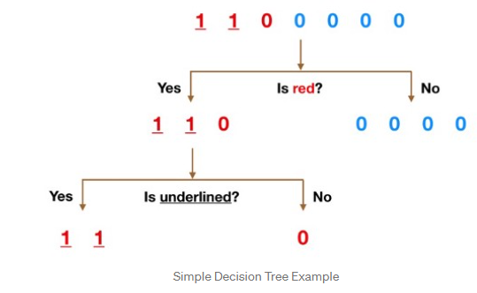
METHODOLOGY
1) SUPPORT VECTOR MACHINES (SVM)
Hyperplane created to separate data into classes
Identify points closest to the line from both the classes.
Compute distance between the line and points
Hyperplane for which the distance is maximum is the optimal hyperplane
Kernels: Linear, RBF, Sigmoid, Polynomial
Dataset
Data Pre-processing
Feature Selection
Classification
2) RANDOM FOREST CLASSIFICATION
Ensemble of Decision Trees
Each tree in the RF is relatively uncorrelated
Ensemble predictions (RF) produce better results than individual predictions (a single decision tree)
Validation

Slide 16
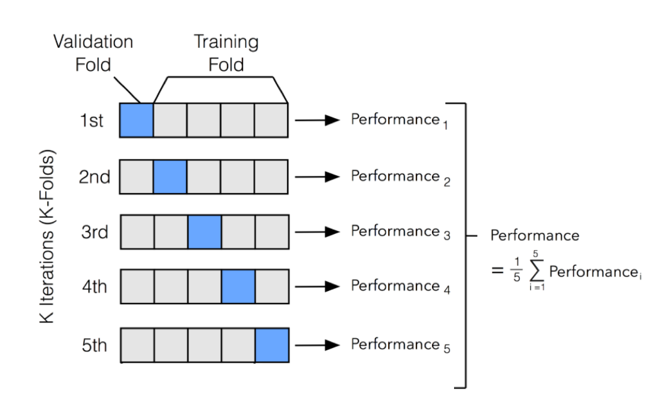
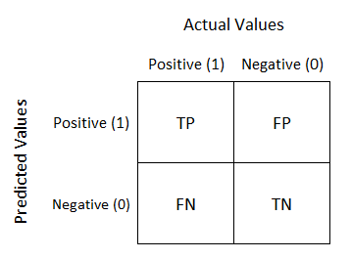
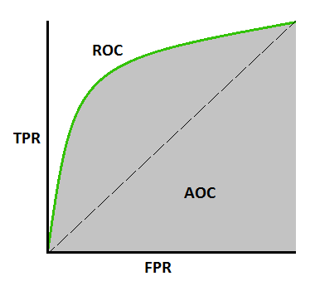



METHODOLOGY
2) K-FOLD CROSS VALIDATION
Dataset shuffled randomly
Split dataset into k number of subsets
For each iteration, conduct model training on k-1 subsets, test the model on the remaining subset
Keep evaluation score, discard the model and repeat for all subsets
Overall evaluation is the mean evaluation score
1) HOLDOUT METHOD (TRAIN-TEST SPLIT)
Dataset split into Training Set and Test Set
Ratio: (80/20 for Train/Test)
Dataset
Data Pre-processing
EVALUATION SCORE COMPONENTS
Accuracy score
Confusion Matrix, Recall, Precision, F-score
Area Under The Curve (AUC) - Receiver Operating Characteristics (ROC) curve
Feature Selection
Classification
Validation
AUC-ROC Curve
Confusion Matrix

Slide 17
GANTT CHART
TASK | FYP 1
 | W1 | W2 | W3 | W4 | W5 | W6 | W7 | W8 | W9 | W10 | W11 | W12
 | 4/1 - 8/1 | 11/1 - 15/1 | 18/1 - 22/1 | 25/1 - 29/1 | 1/2 - 5/2 | 8/2 - 12/2 | 15/2 - 19/2 | 22/2 - 26/2 | 1/3 - 5/3 | 8/3 - 12/3 | 15/3 - 19/3 | 22/3 - 26/3
Conduct research and literature review
Finalise dataset collection and confirmation of dataset to be used
Identify suitable features for model training from dataset
Identify appropriate algorithm to do classification
Data cleaning, verification, and formatting (pre-processing)
Building and splitting of dataset (training/validation/test)
Model training and refinement

Slide 18
GANTT CHART
TASK | FYP 2
 | W1 | W2 | W3 | W4 | W5 | W6 | W7 | W8 | W9 | W10 | W11 | W12
 | 3/5 - 7/5 | 10/5 - 14/5 | 17/5 - 21/5 | 24/5 - 28/5 | 31/5 - 4/6 | 7/6 - 11/6 | 14/6 - 18/6 | 21/6 - 25/6 | 28/6 - 2/7 | 5/7 - 9/7 | 12/7 - 16/7 | 19/7 - 23/7
Model training and refinement
Model evaluation

Slide 19
PRELIMINARY PROGRESS AND RESULTS
1) DATA PRE-PROCESSING
Final Dataset Shape:
1007 rows
47 columns (45 features)
ANALYSING CLASS SIZES
Frail: 7
Frail + MCI: 76
MCI: 133
Prefrail + MCI: 231
Prefrail: 221
Robust: 339
2) CLASSIFICATION
Accuracy (80/20 split):
Logistic Regression (Log): 0.347
Linear Discriminant Analysis (LDA): 0.396
K-Nearest Neigbors (kNN): 0.302
Classification and Regression Trees (CART): 0.238
Gaussian Naive Bayes (GNB): 0.347
Support Vector Machines (SVM): 0.342
Random Forest Classifier (RFC): 0.371
Accuracy (Cross-Validation)
Log: 0.35 std dev 0.04
LDA: 0.36 std dev 0.04
kNN: 0.32 std dev 0.03
CART: 0.27 std dev 0.05
GNB: 0.32 std dev 0.04
SVM: 0.34 std dev 0.00
RFC: 0.37 std dev 0.04
Data imbalance is significant!
POSSIBLE MITIGATION APPROACHES
Group into Non-Robust and Robust
Choose ends of spectrum (Robust and Frail+MCI)
SMOTE Technique (synthesise data to balance dataset – 339 for all samples)

Slide 20
PRELIMINARY PROGRESS AND RESULTS
1) ROBUST VS NON-ROBUST
Accuracy (80/20 split):
Logistic Regression (Log): 0.668
Linear Discriminant Analysis (LDA): 0.658
K-Nearest Neigbors (kNN): 0.584
Classification and Regression Trees (CART): 0.599
Gaussian Naive Bayes (GNB): 0.53
Support Vector Machines (SVM): 0.658
Random Forest Classifier (RFC): 0.644
Accuracy (Cross-Validation)
Log: 0.67 std dev 0.03
LDA: 0.66 std dev 0.05
kNN: 0.61 std dev 0.04
CART: 0.57 std dev 0.05
GNB: 0.54 std dev 0.09
SVM: 0.66 std dev 0.00
RFC: 0.64 std dev 0.02
2) ROBUST VS FRAIL+MCI
Accuracy (80/20 split):
Logistic Regression (Log): 0.831
Linear Discriminant Analysis (LDA): 0.88
K-Nearest Neigbors (kNN): 0.819
Classification and Regression Trees (CART): 0.771
Gaussian Naive Bayes (GNB): 0.831
Support Vector Machines (SVM): 0.867
Random Forest Classifier (RFC): 0.843
Accuracy (Cross-Validation)
Log: 0.81 std dev 0.05
LDA: 0.81 std dev 0.04
kNN: 0.80 std dev 0.03
CART: 0.76 std dev 0.06
GNB: 0.81 std dev 0.04
SVM: 0.82 std dev 0.01
RFC: 0.82 std dev 0.03
2) SMOTE TECHNIQUE (ALL CLASSES)
Accuracy (80/20 split):
Logistic Regression (Log): 0.376
Linear Discriminant Analysis (LDA): 0.437
K-Nearest Neigbors (kNN): 0.563
Classification and Regression Trees (CART): 0.504
Gaussian Naive Bayes (GNB): 0.486
Support Vector Machines (SVM): 0.504
Random Forest Classifier (RFC): 0.742
Accuracy (Cross-Validation)
Log: 0.39 std dev 0.04
LDA: 0.47 std dev 0.05
kNN: 0.59 std dev 0.07
CART: 0.56 std dev 0.06
GNB: 0.45 std dev 0.04
SVM: 0.53 std dev 0.04
RFC: 0.76 std dev 0.08

Slide 21
CONCLUSION
Cognitive Frailty (CF) is a prevalent condition affecting older adults, which requires prompt medical intervention by medical professionals
The existence of a classification model for Cognitive Frailty (CF) helps in identifying the condition among older adults
By implementing a classification model using biomarkers such as blood parameters, it is possible to identify Cognitive Frailty using tissue and serum collection from patients, rather than the existing clinical measurements

Slide 22
REFERENCES
[1] Buchman, A. and Bennett, D., 2013. Cognitive frailty. The journal of nutrition, health & aging, 17(9), pp.738-739.
[2] H. Shimada, H. Makizako, T. Doi, K. Tsutsumimoto, S. Lee, and T. Suzuki, “P3-371: Impact of Cognitive Frailty on Daily Activities in Older Persons,” Alzheimers & Dementia, vol. 12, 2016.
[3] C. Cano, R. Samper-Ternent, S. A. Snih, K. Markides, and K. J. Ottenbacher, “Frailty and cognitive impairment as predictors of mortality in older Mexican Americans,” The journal of nutrition, health & aging, vol. 16, no. 2, pp. 142–147, 2011.
[4] “Population by age group, sex and ethnic group, 2010 - 2019e, Malaysia,” Department of Statistics Malaysia Official Portal. [Online]. Available: https://www.dosm.gov.my/v1/index.php?r=column3/accordion&menu_id=aHhRYUpWS3B4VXlYaVBOeUF0WFpWUT09. [Accessed: 06-Feb-2021].
[5] N. Malek Rivan et al., "Cognitive frailty among Malaysian older adults: baseline findings from the LRGS TUA cohort study", Clinical Interventions in Aging, vol. 14, pp. 1343-1352, 2019. Available: 10.2147/cia.s211027 [Accessed 6 February 2021].
[6] Z. S. Nasreddine, N. A. Phillips, V. R. Bã©Dirian, S. Charbonneau, V. Whitehead, I. Collin, J. L. Cummings, and H. Chertkow, “The Montreal Cognitive Assessment, MoCA: A Brief Screening Tool For Mild Cognitive Impairment,” Journal of the American Geriatrics Society, vol. 53, no. 4, pp. 695–699, 2005.
[7] Fried LP, Tangen CM, Walston J, et al. (2001) Frailty in older adults: evidence for a phenotype. J Gerontol A Biol Sci Med Sci, 56 (3): p. M146-56.
[8] E. Kelaiditi, M. Cesari, M. Canevelli, G. A. V. Kan, P.-J. Ousset, S. Gillette-Guyonnet, P. Ritz, F. Duveau, M. E. Soto, V. Provencher, F. Nourhashemi, A. Salva, P. Robert, S. Andrieu, Y. Rolland, J. Touchon, J. L. Fitten, and B. Vellas, “Cognitive frailty: Rational and definition from an (I.A.N.A./I.A.G.G.) International Consensus Group,” The journal of nutrition, health & aging, vol. 17, no. 9, pp. 726–734, 2013.

Slide 23
REFERENCES
[9] F. Babič, L. T. Majnarić, S. Bekić, and A. Holzinger, “Machine Learning for Family Doctors: A Case of Cluster Analysis for Studying Aging Associated Comorbidities and Frailty,” Lecture Notes in Computer Science Machine Learning and Knowledge Extraction, pp. 178–194, 2019.
[10] M. S. Crane, “Classification and prediction of clinical Alzheimers diagnosis based on plasma signalling proteins,” Annals of Clinical Biochemistry, vol. 45, no. 2, pp. 231–232, 2008.
[11] J. D. Doecke, “Blood-Based Protein Biomarkers for Diagnosis of Alzheimer Disease,” Archives of Neurology, vol. 69, no. 10, p. 1318, 2012.
[12] A. P. Hassler, E. Menasalvas, F. J. García-García, L. Rodríguez-Mañas, and A. Holzinger, “Importance of medical data preprocessing in predictive modeling and risk factor discovery for the frailty syndrome,” BMC Medical Informatics and Decision Making, vol. 19, no. 1, 2019.
[13] Y. C. Youn, S. H. Choi, H.-W. Shin, K. W. Kim, J.-W. Jang, J. J. Jung, G.-Y. R. Hsiung, and S. Kim, “Detection of cognitive impairment using a machine-learning algorithm,” Neuropsychiatric Disease and Treatment, vol. Volume 14, pp. 2939–2945, 2018.
[14] R. Buettner and M. Schunter, “Efficient machine learning based detection of heart disease,” 2019 IEEE International Conference on E-health Networking, Application & Services (HealthCom), 2019.

